Slide 1

Mobile App Development with Flutter
Francis Deh

Slide 2
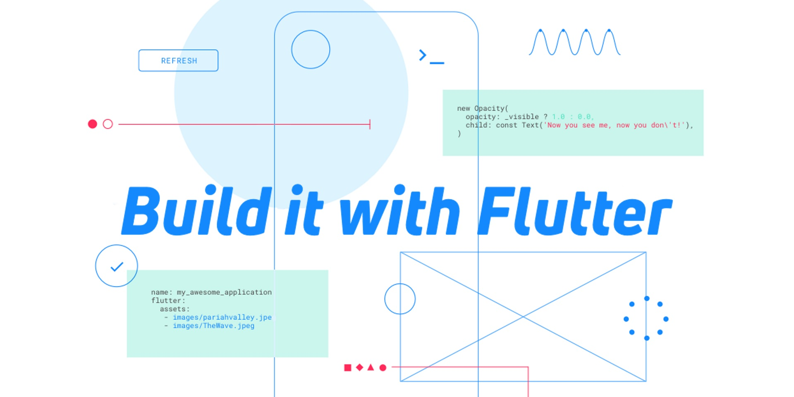
Mobile App Development with Flutter

Slide 3
Objectives
Introduction to Flutter
Project Based Development
Dart in Details
1
3
5
2
4
Overview of Dart
Flutter Setup

Slide 4
Introduction to Flutter

Slide 5
What is flutter?
Flutter is a set of tooling that allows us to create beautiful apps that run on iOS, Android, the Web, and desktop.1

Slide 6
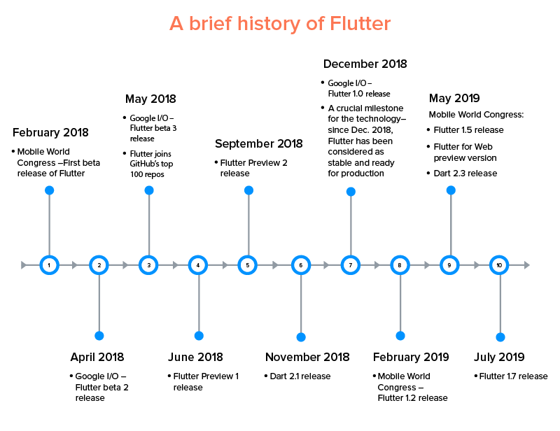

Slide 7
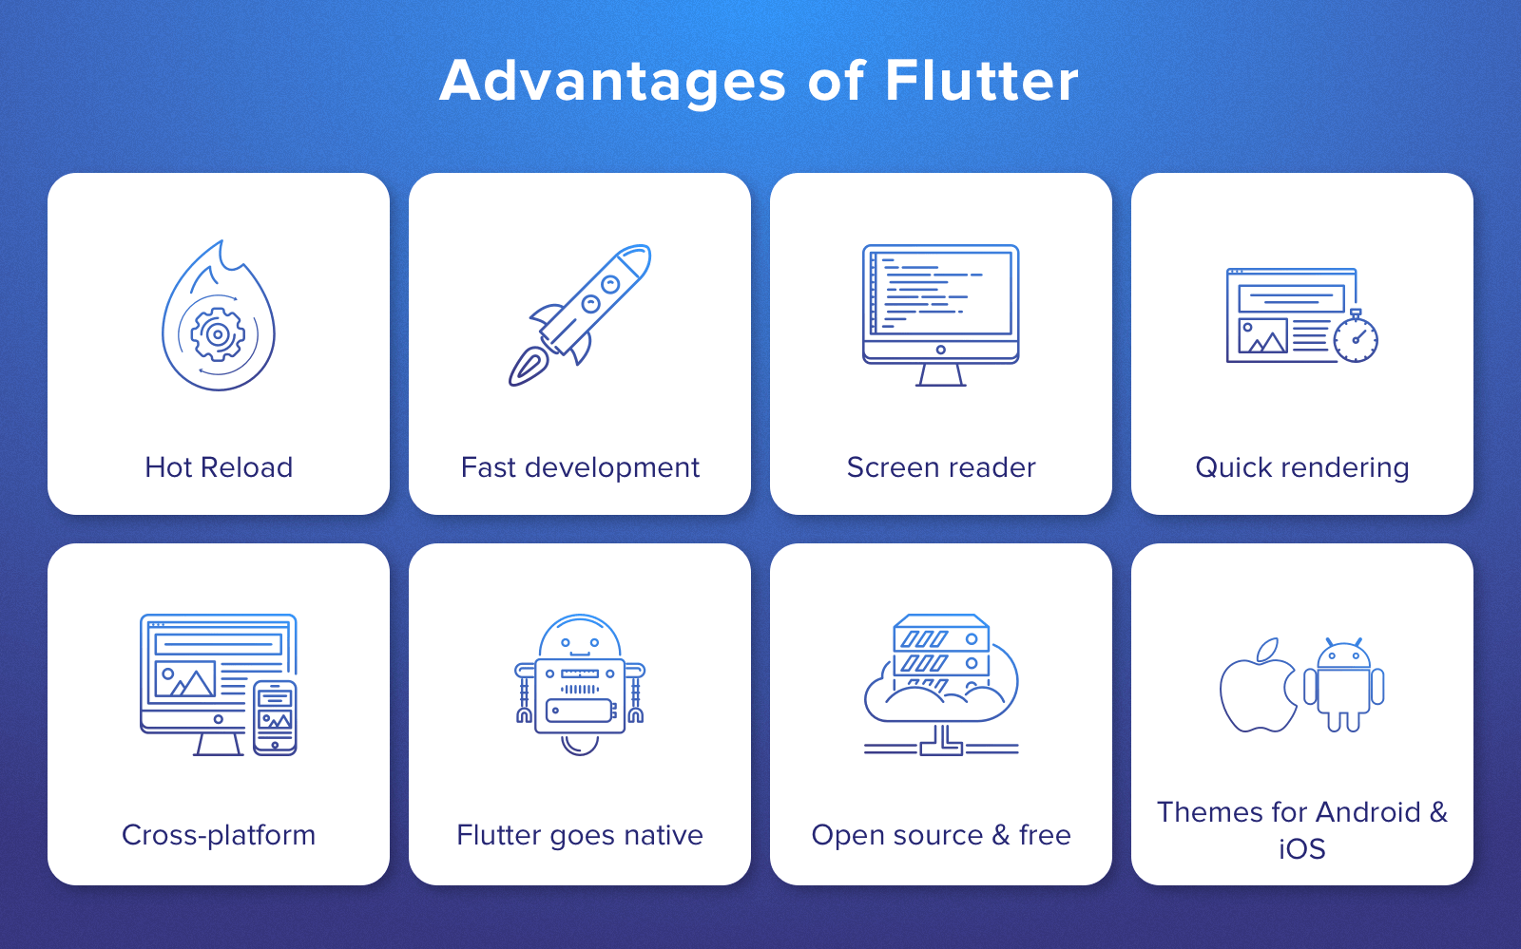

Slide 8
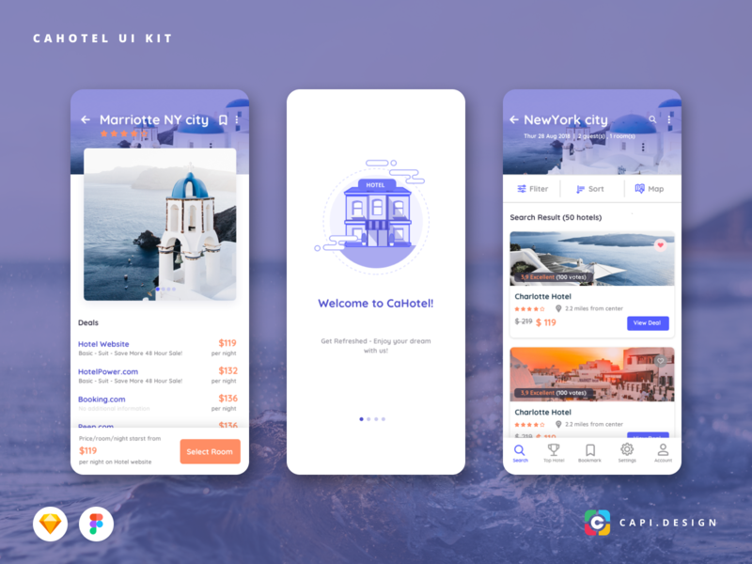

Slide 9
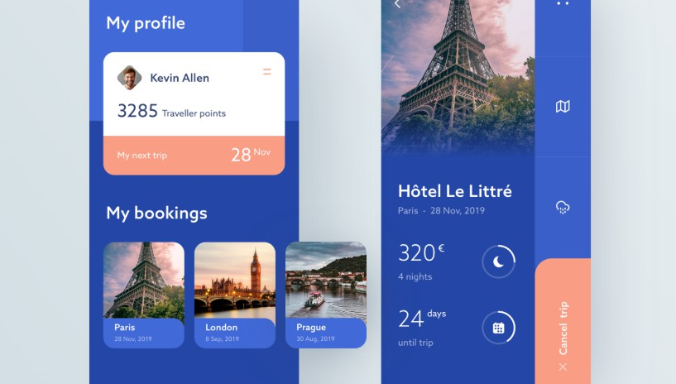

Slide 10
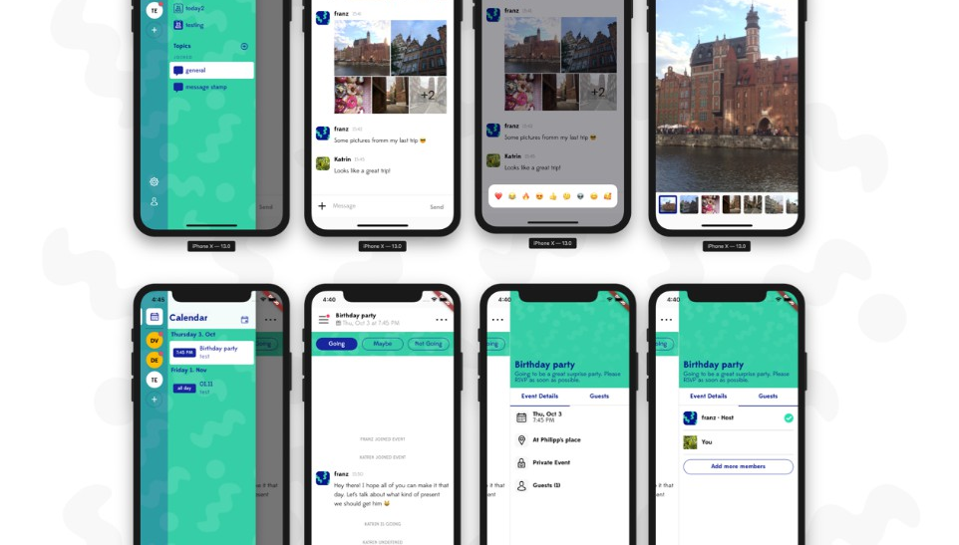

Slide 11
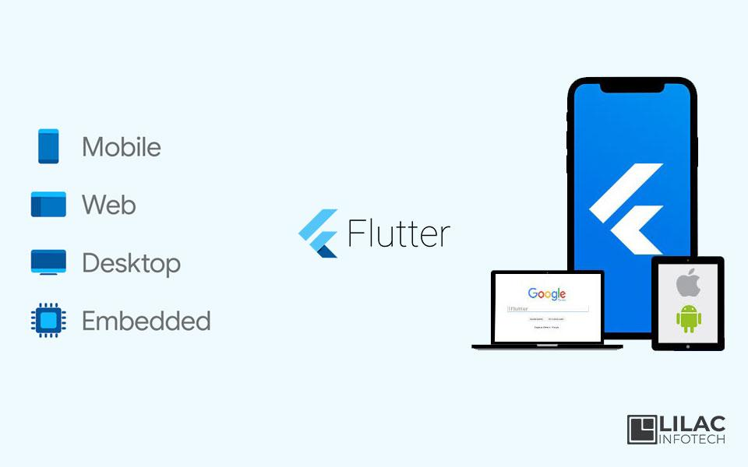

Slide 12
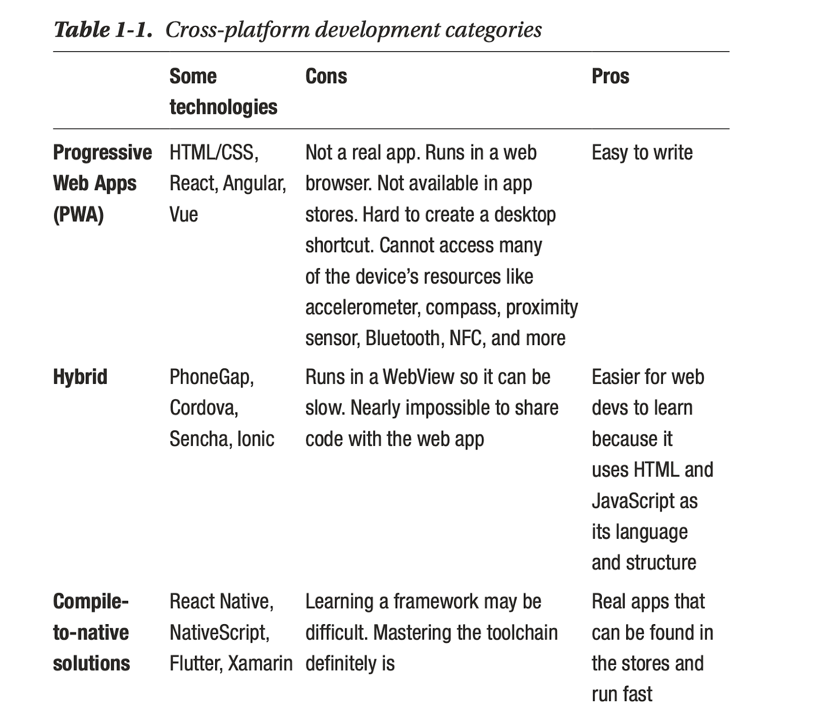

Slide 13
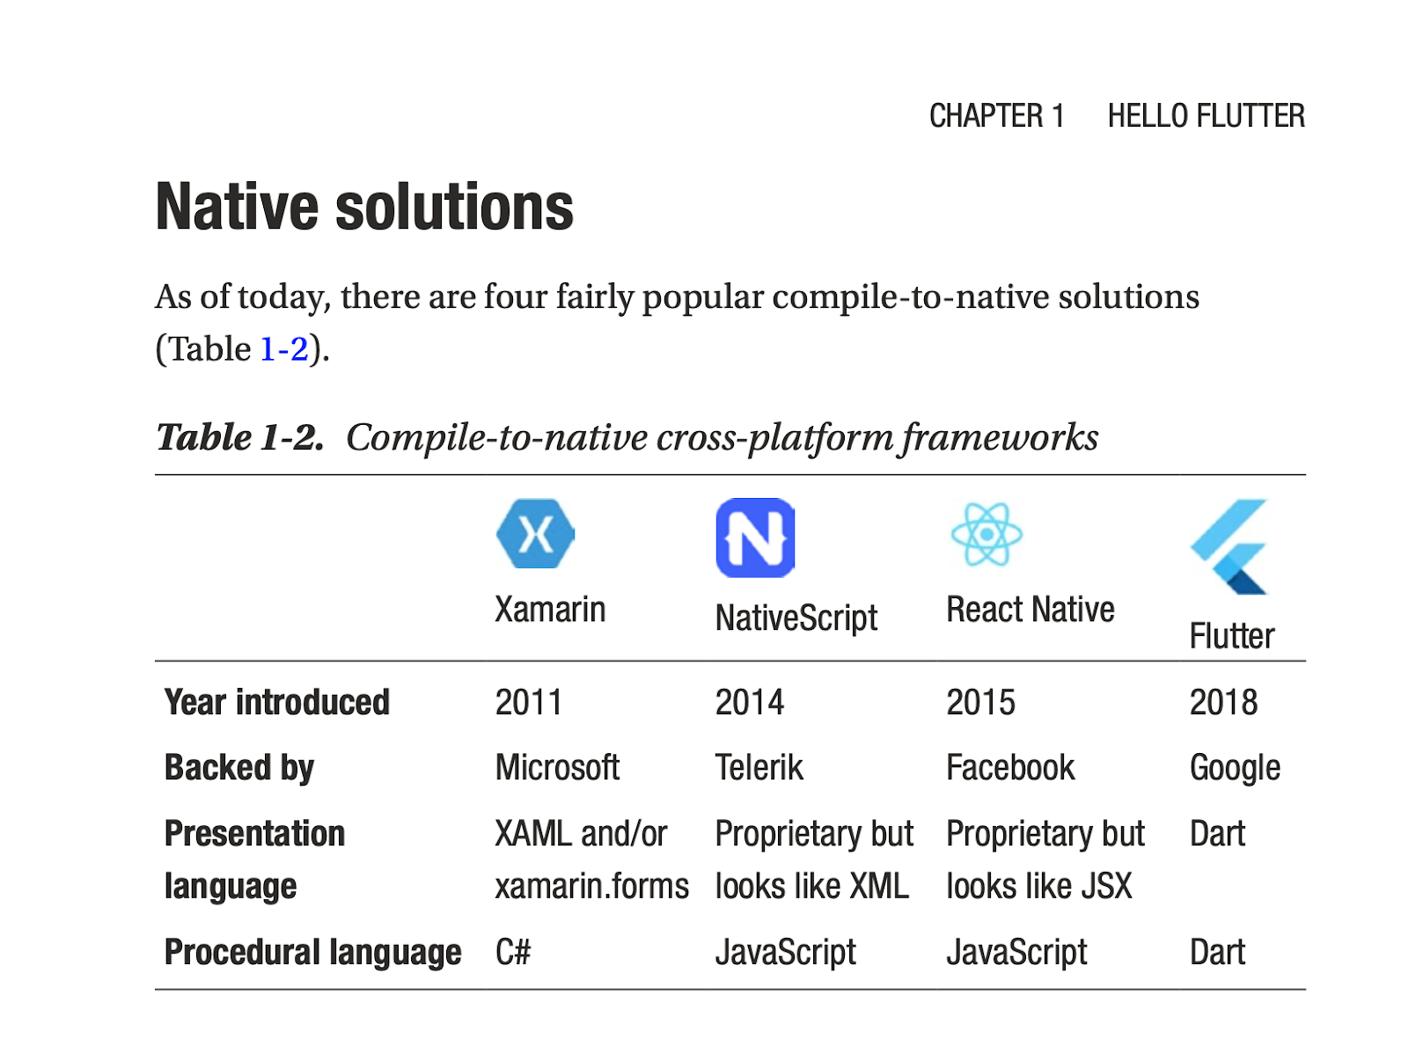

Slide 14
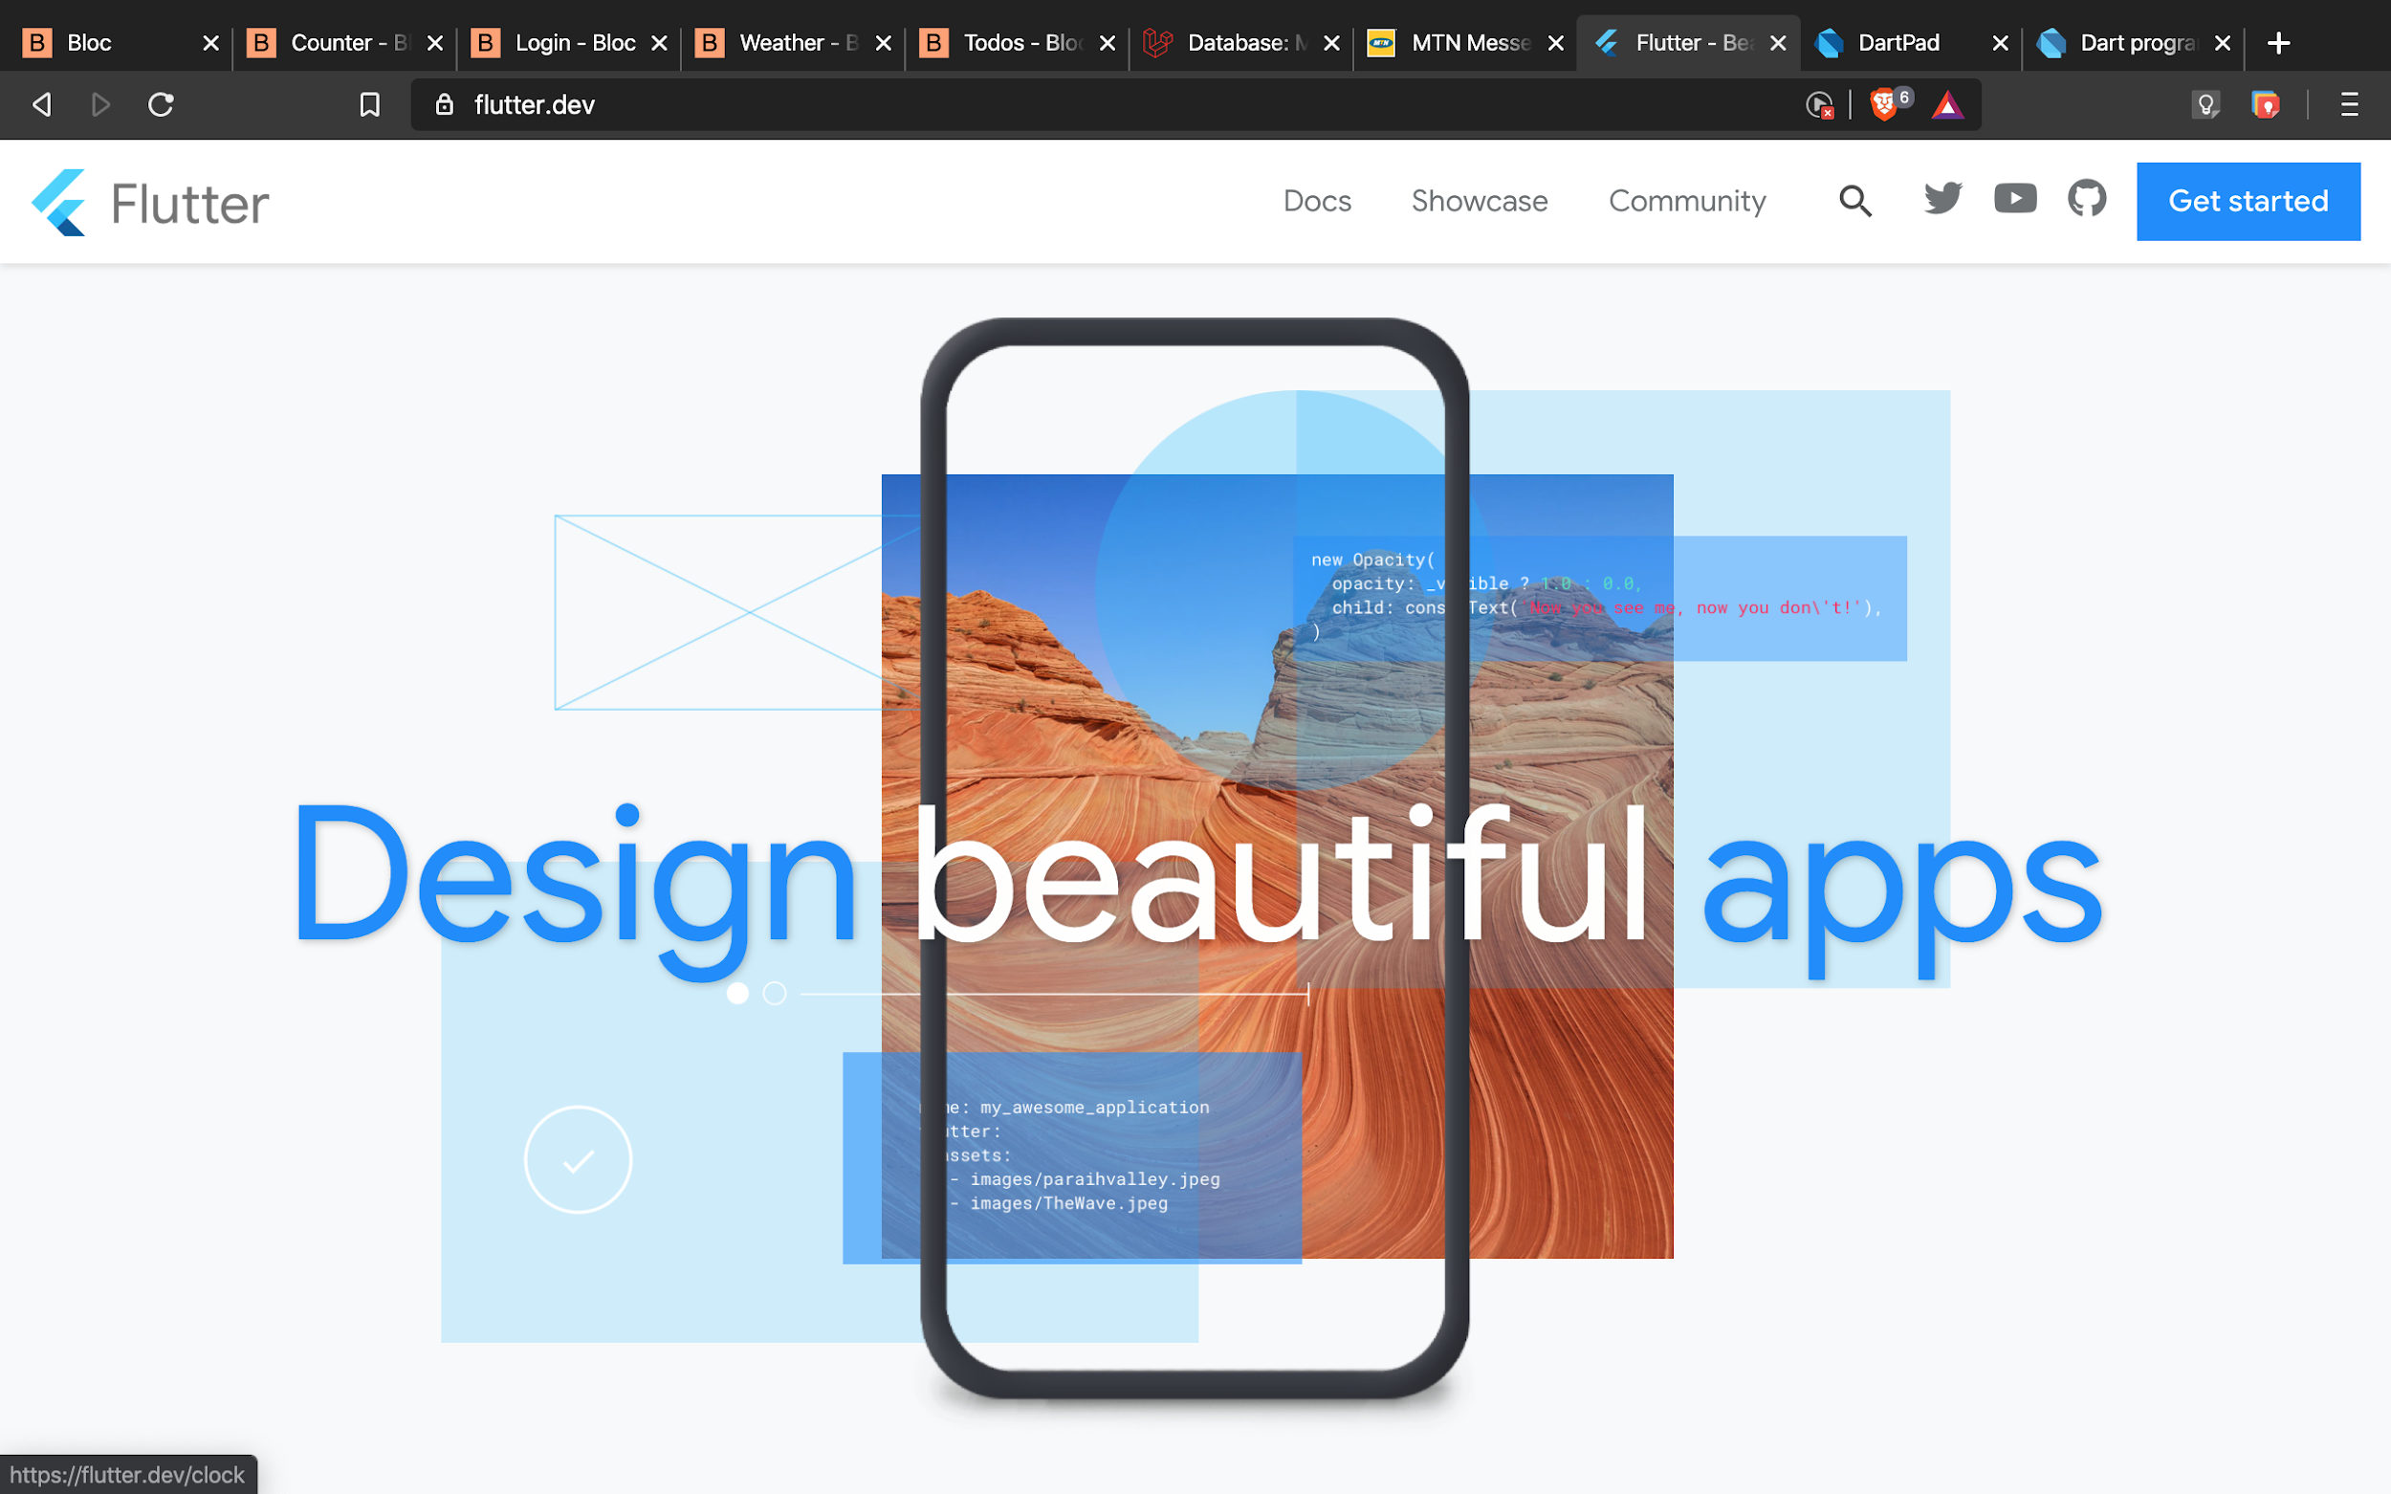

Slide 15
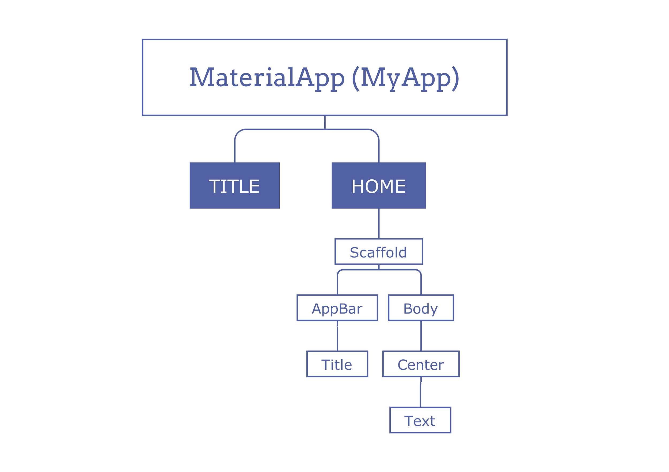

Slide 16
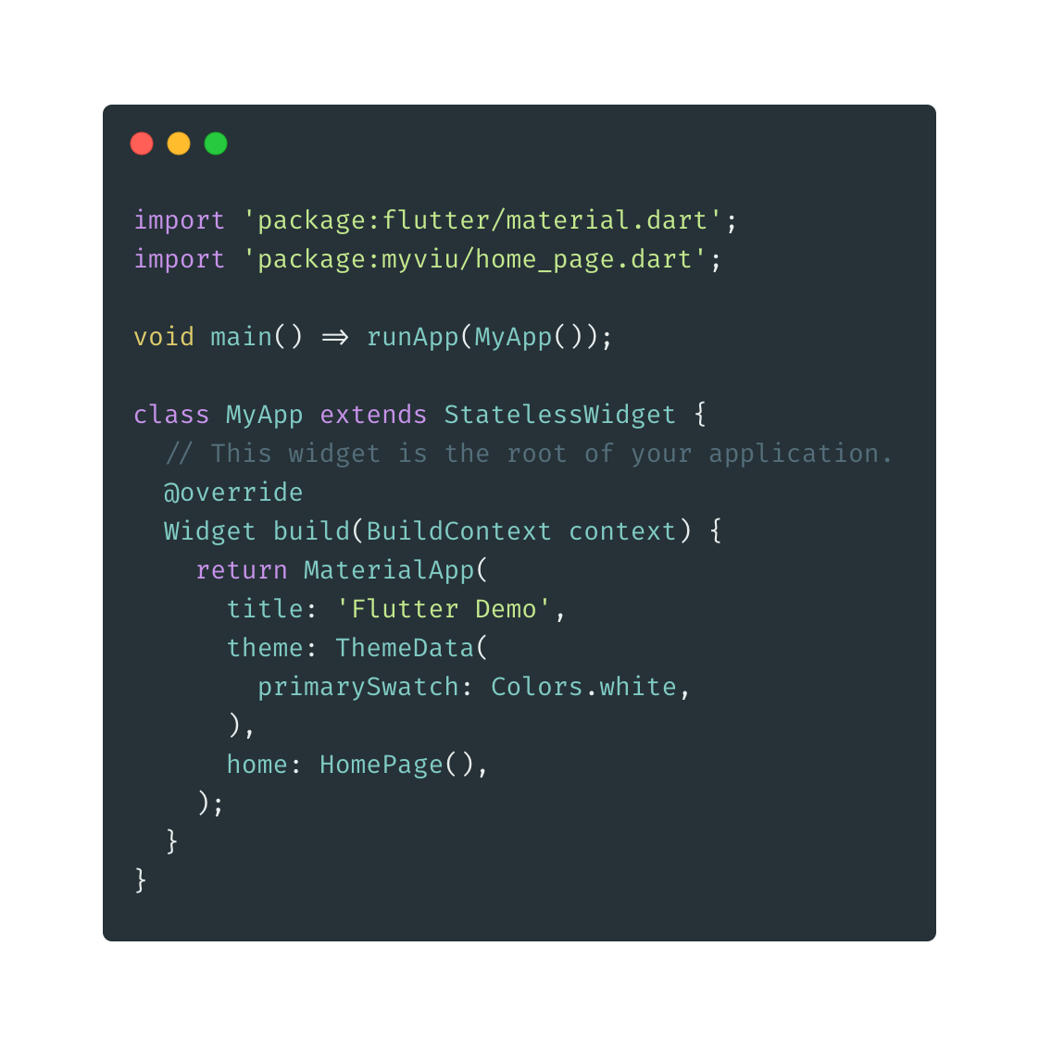

Slide 17
Programming with Dart

Slide 18
What is Programming?
Computer programming is the process of designing and building an executable computer program to accomplish a specific computing result.
In this case, we will use Dart.

Slide 19
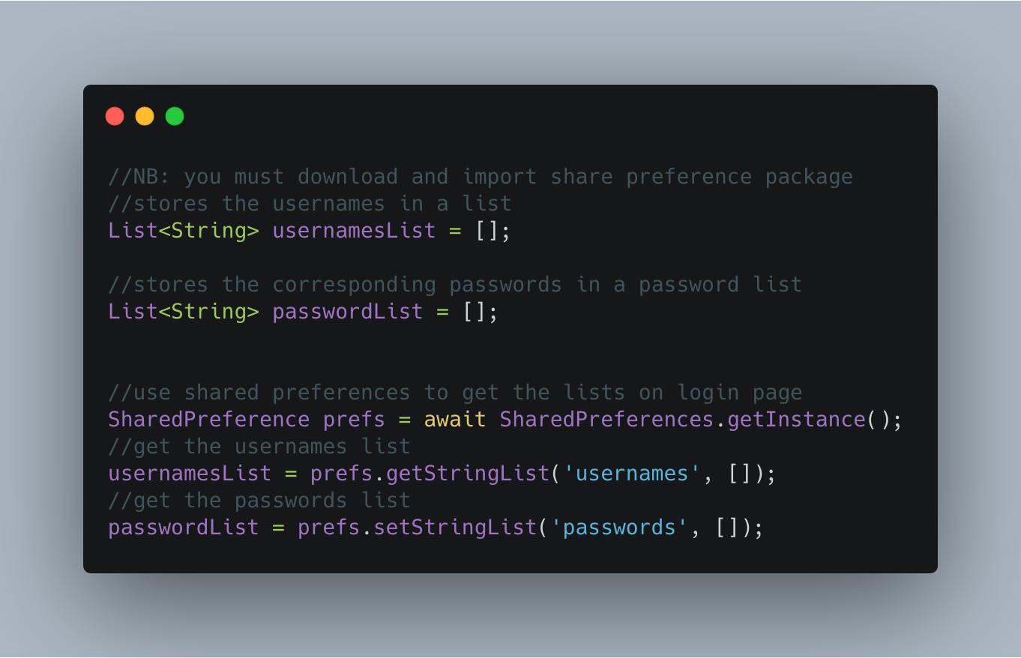

Slide 20
Project Based Development

Slide 21
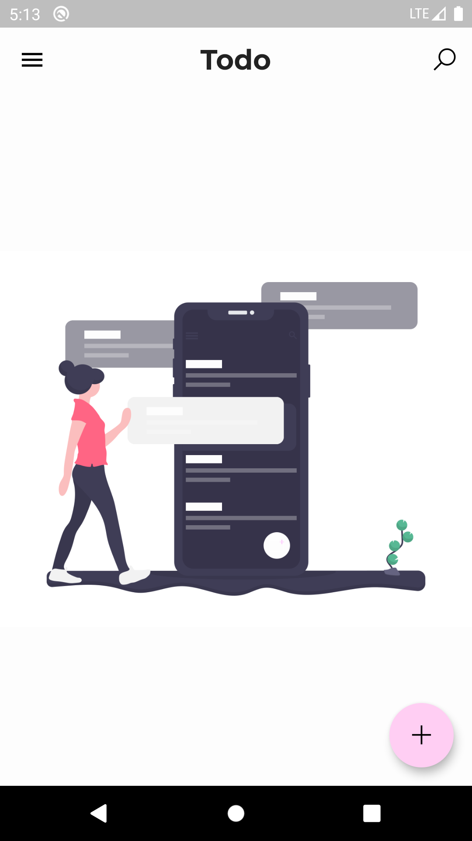
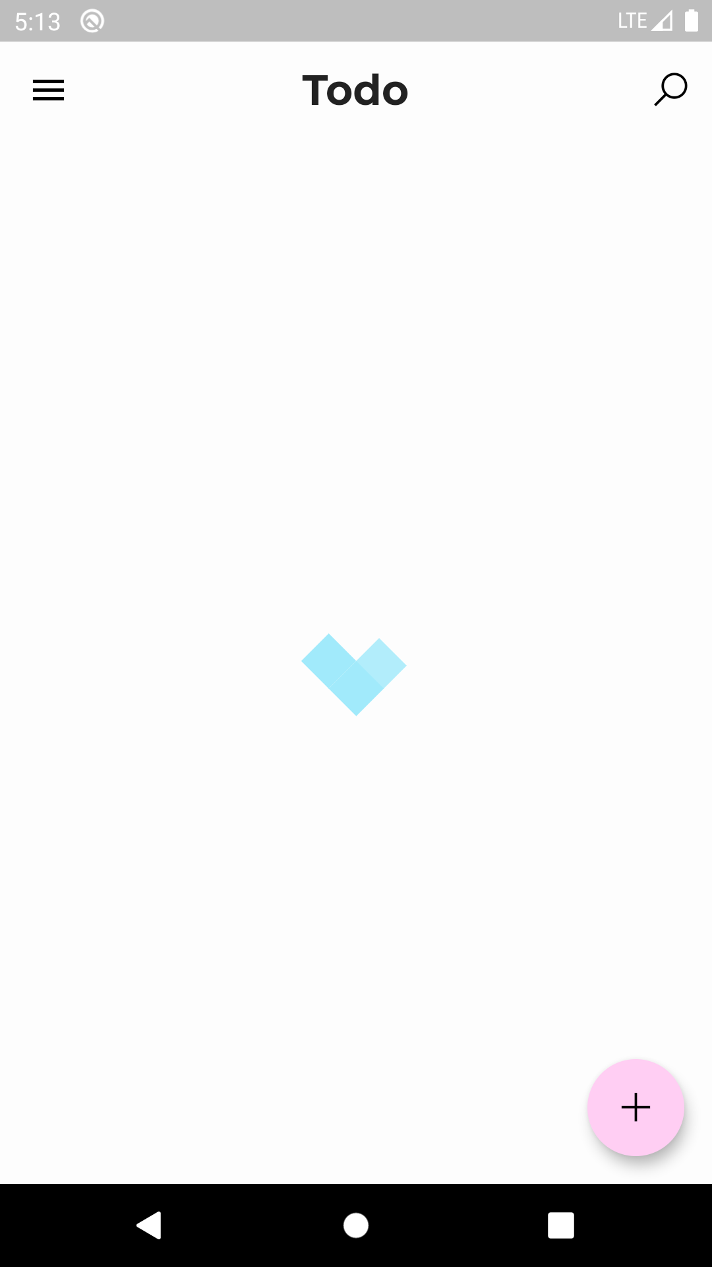
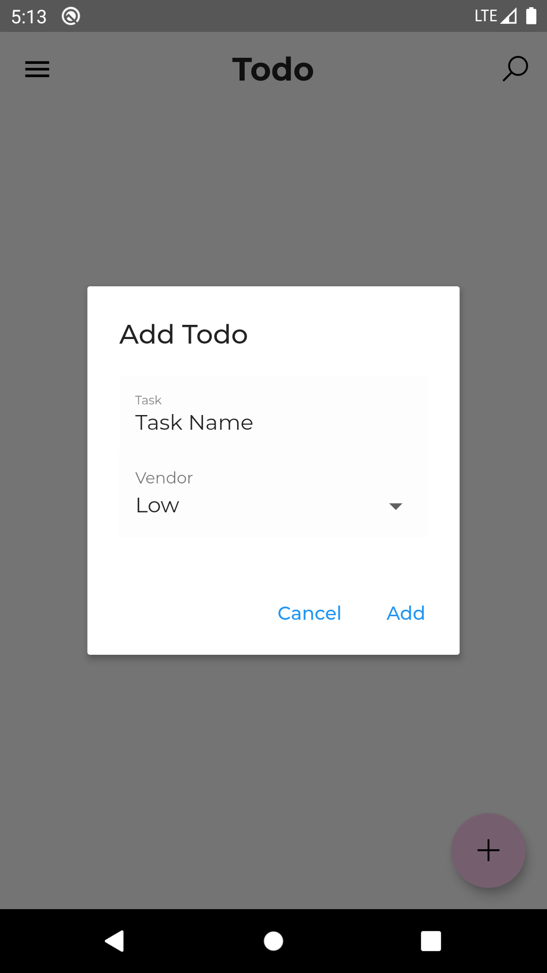

Slide 22
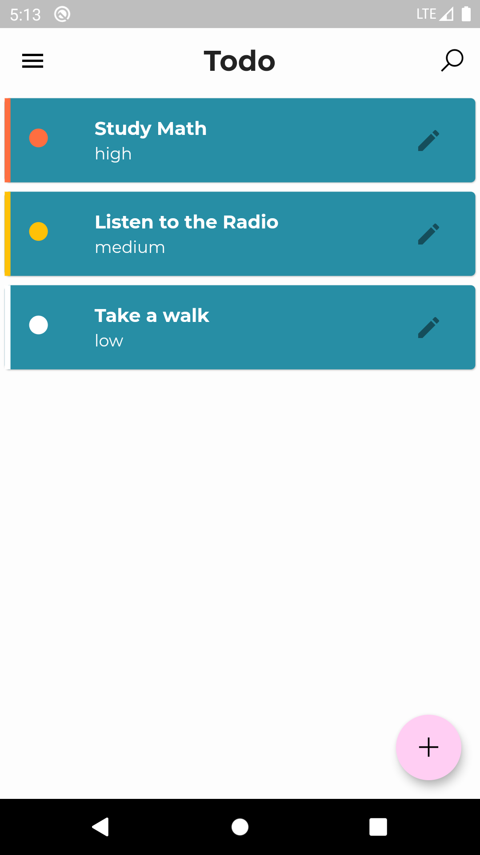
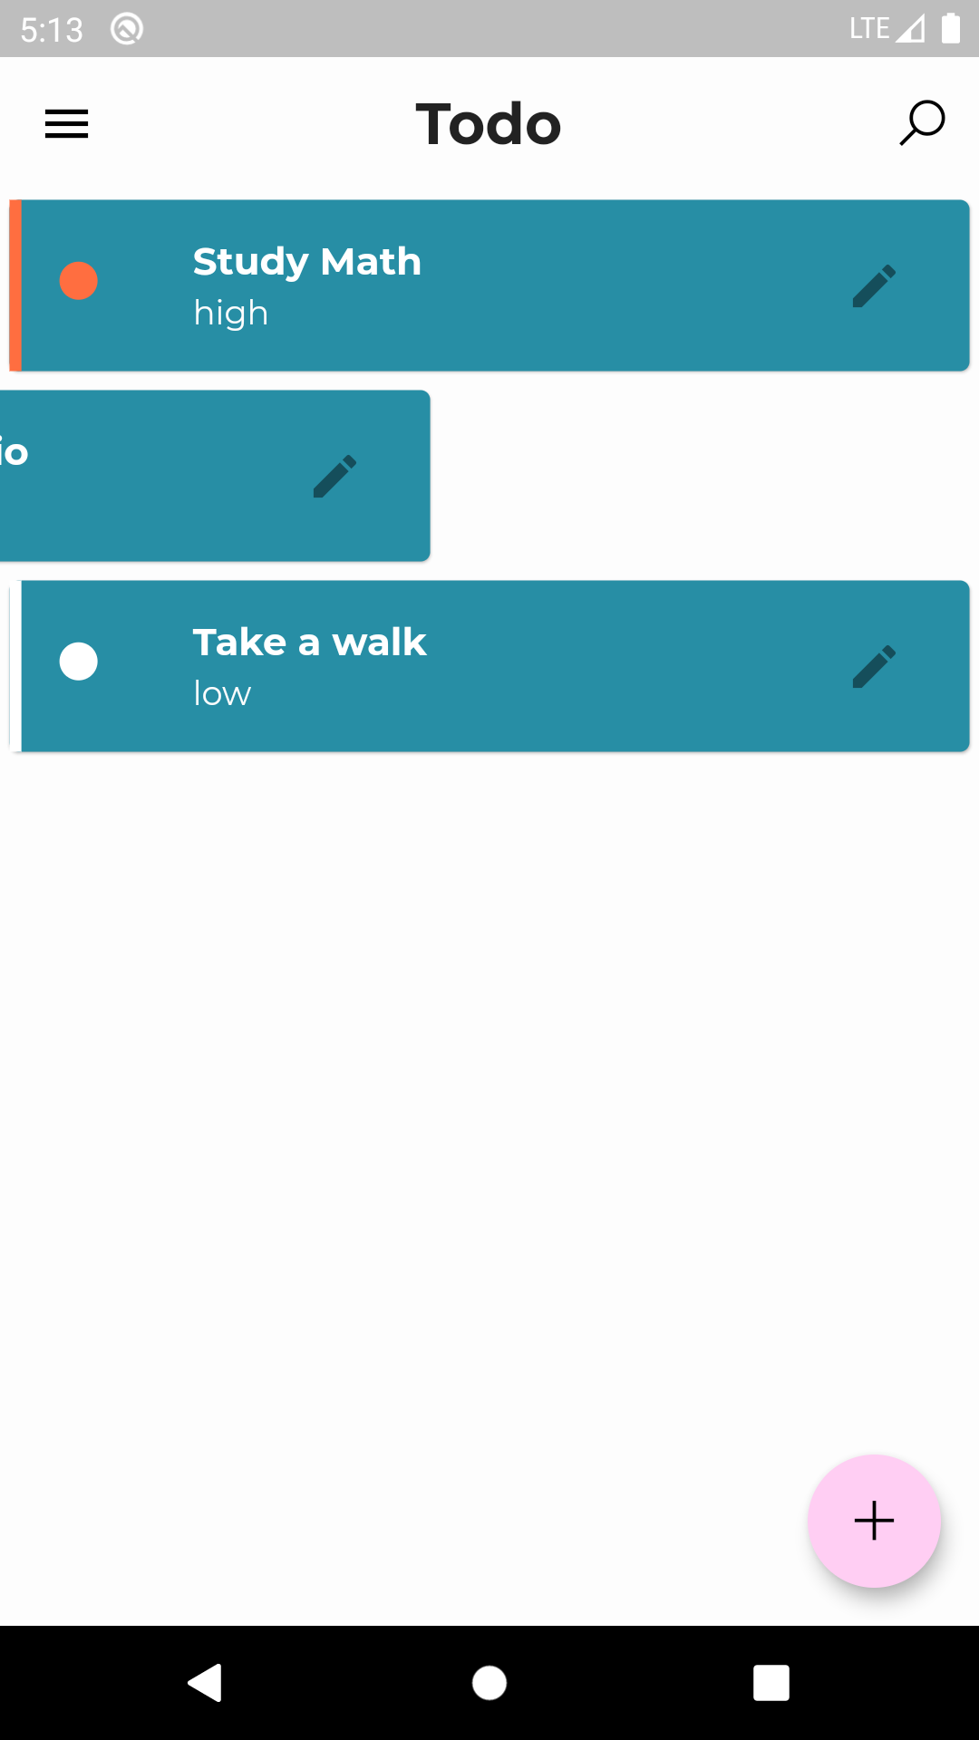

Slide 23
Todo App Core features
Routing
05
Local Storage
01
04
Custom Theming
Widgets
02
03
CRUD - Create, Read, Update and Delete

Slide 24
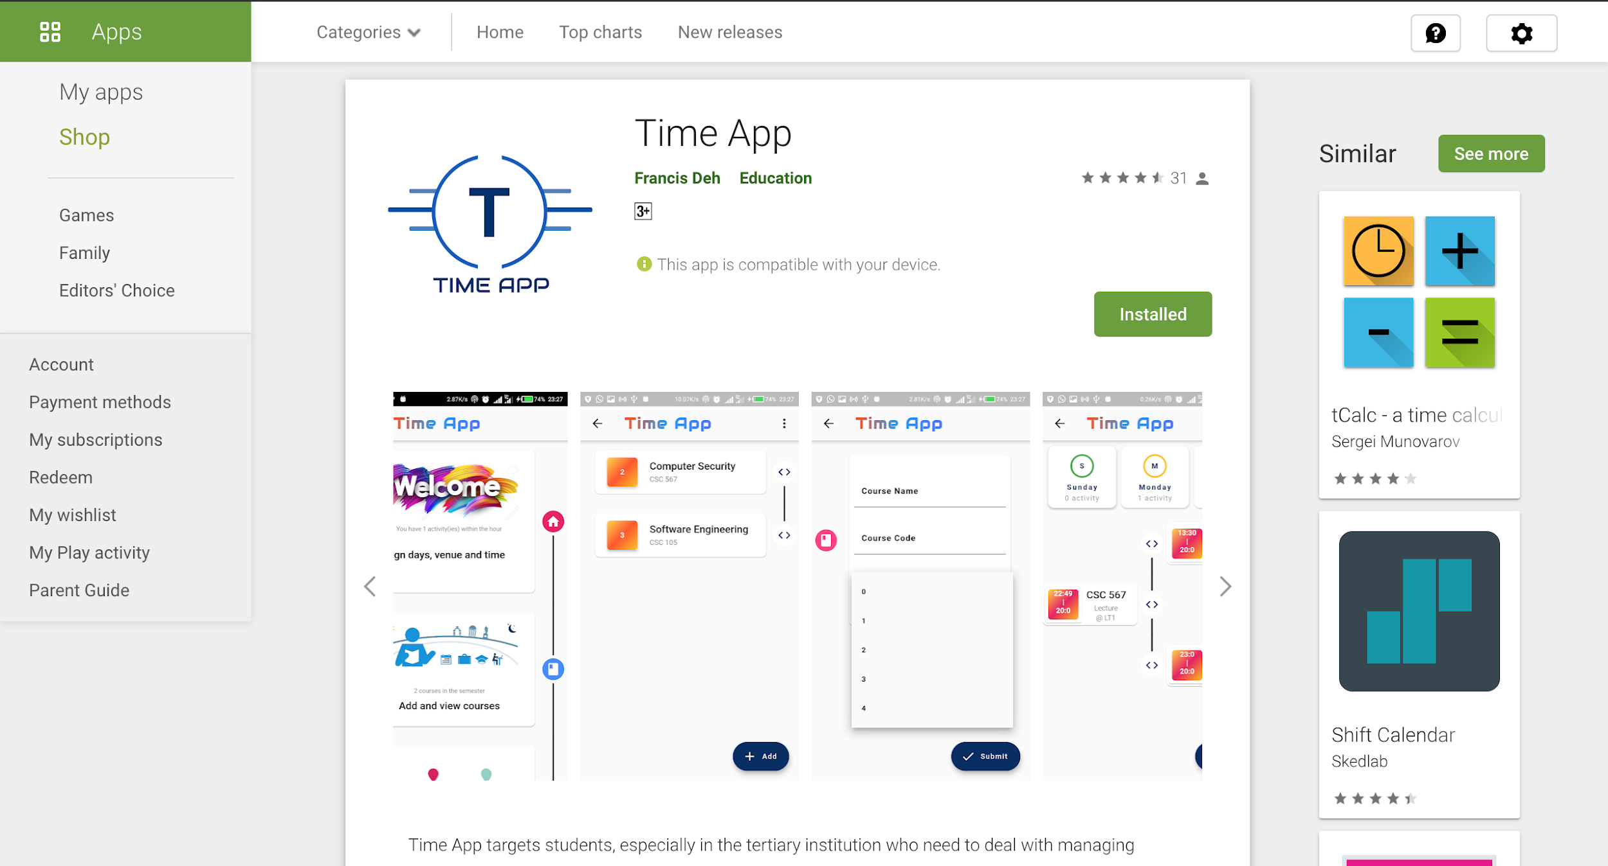

Slide 25
Flutter Development Setup

Slide 26
Core Setup Process - (refer to Docs and attached video)
SDK
Software Development Kit
05
Running First App
01
04
Emulator
IDE
Integrated Development Environment
02
03
IDE Dev tools

Slide 27
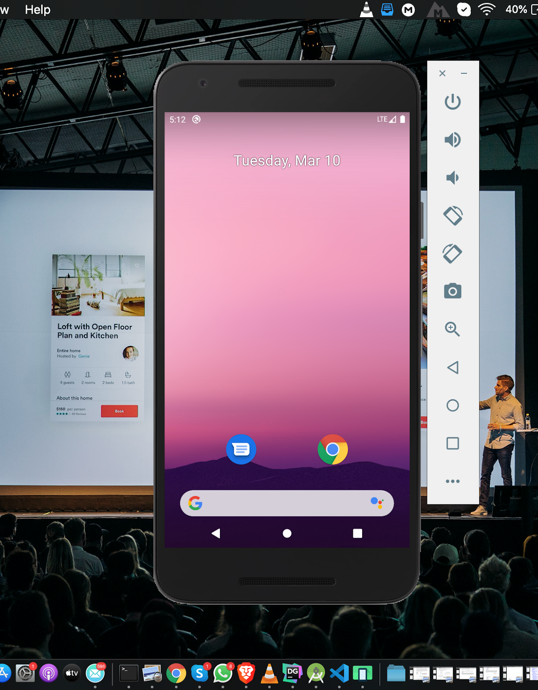
Using Emulator - (refer to Docs and attached video)
Android Emulator
Actual Device
The Real Device connected can be used as well

Slide 28
Dart into Details

Slide 29
Using the Dart Pad
Data types
Conditionals
Arrays/List
Loops
Functions
Classes

Slide 30
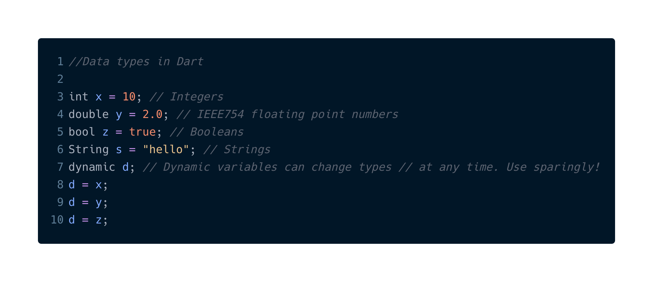

Slide 31
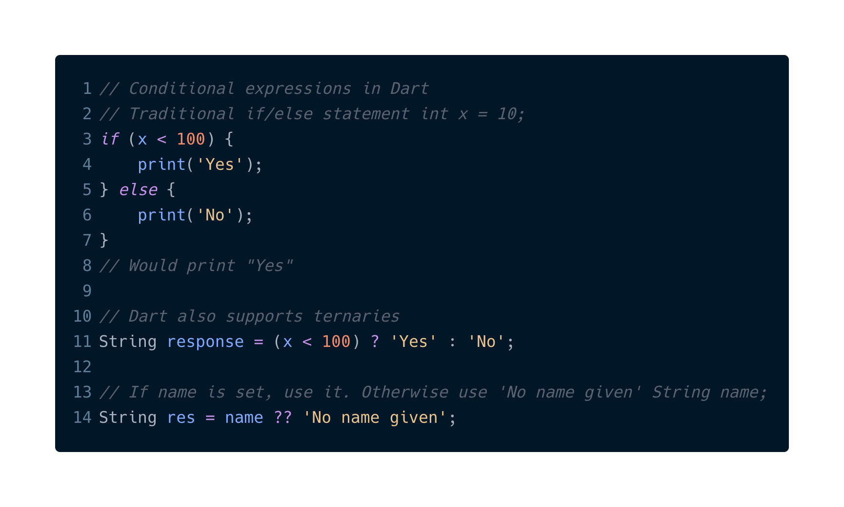

Slide 32
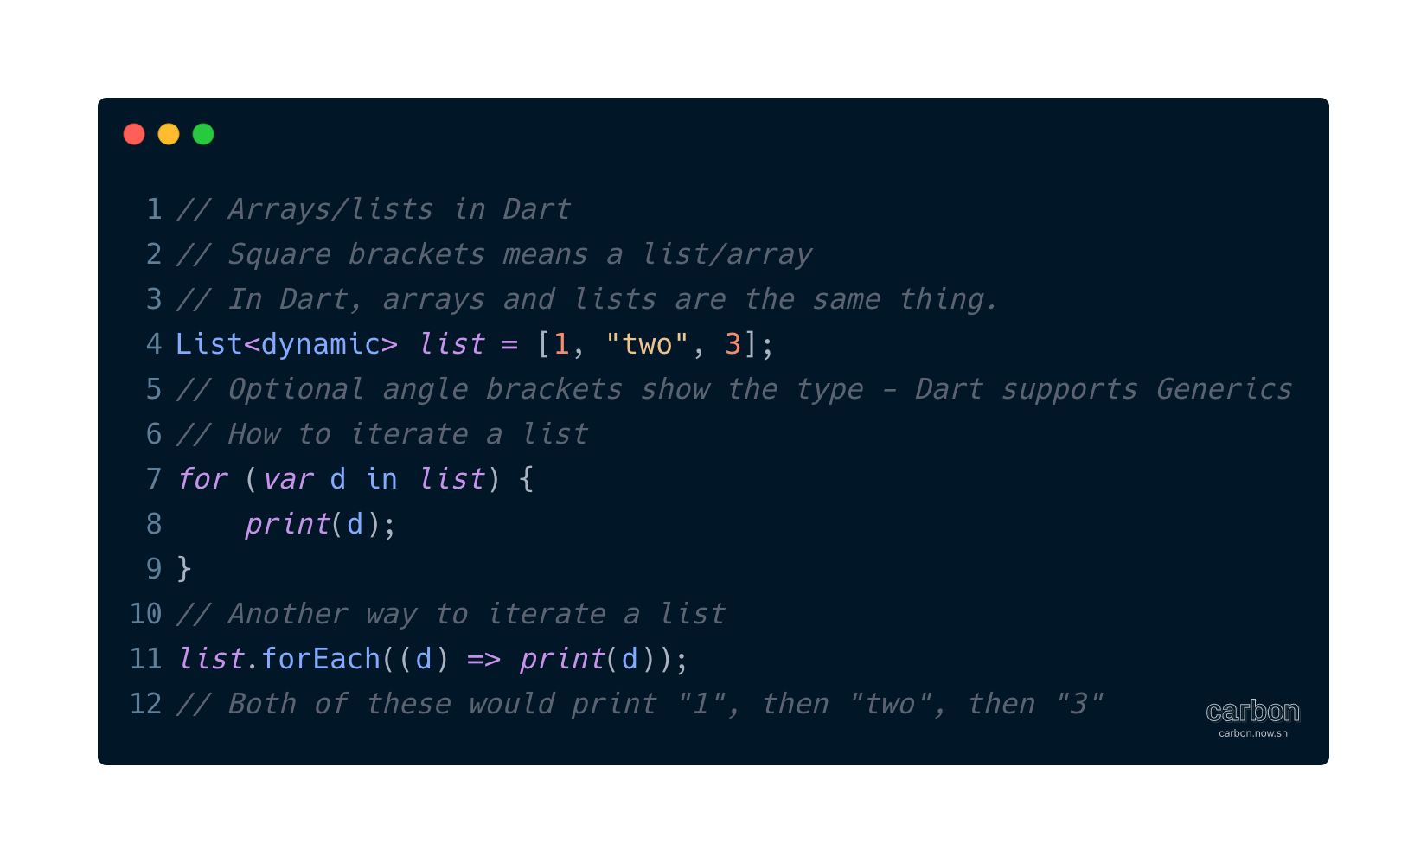

Slide 33
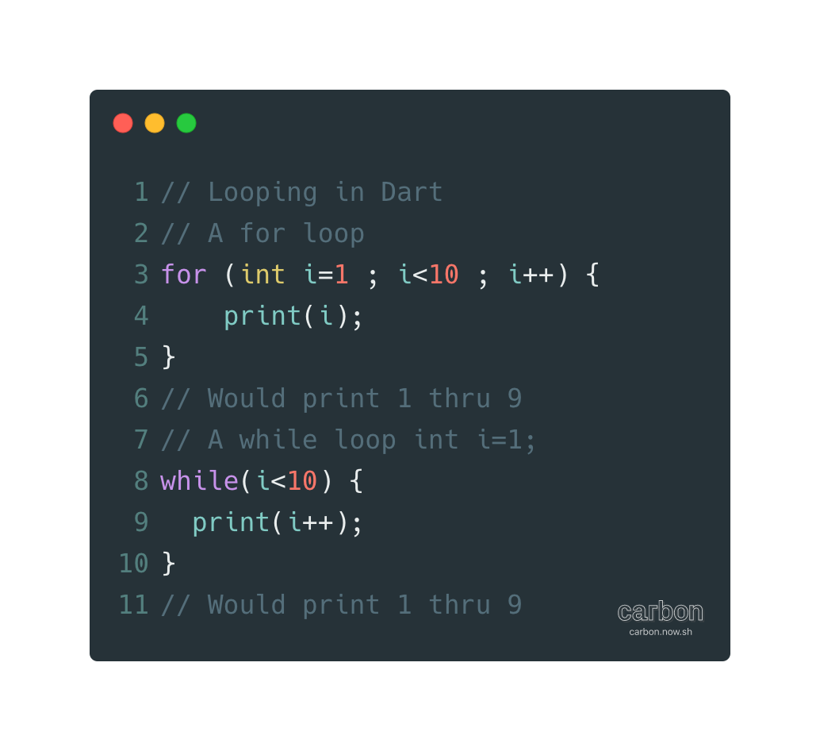

Slide 34
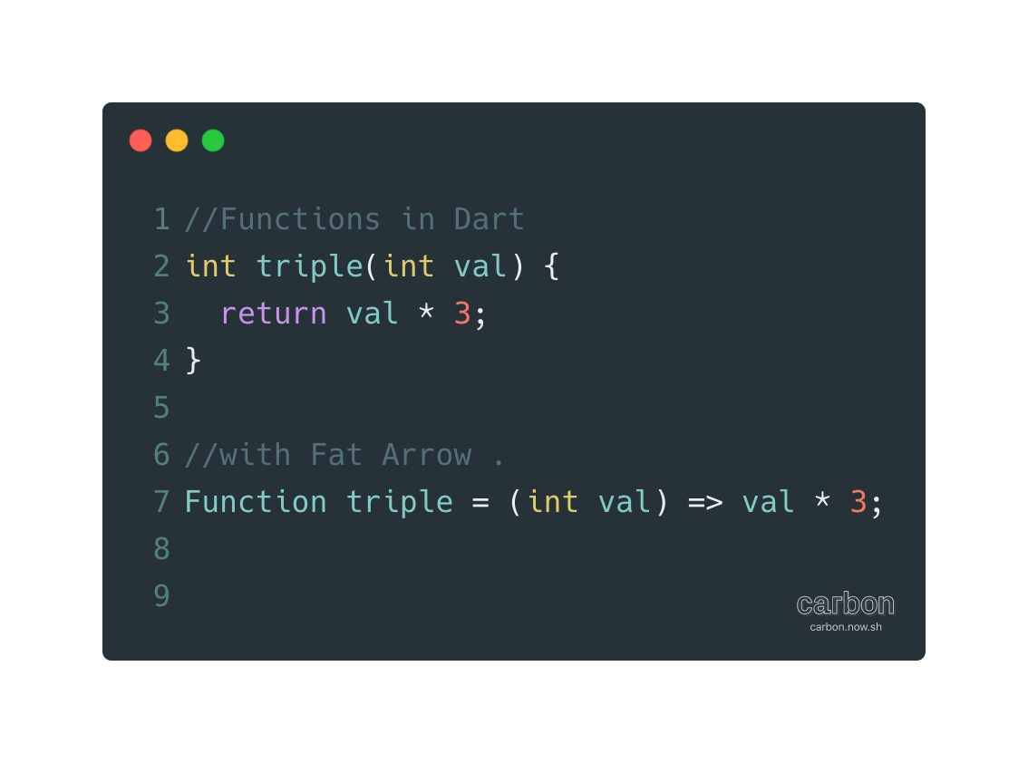

Slide 35
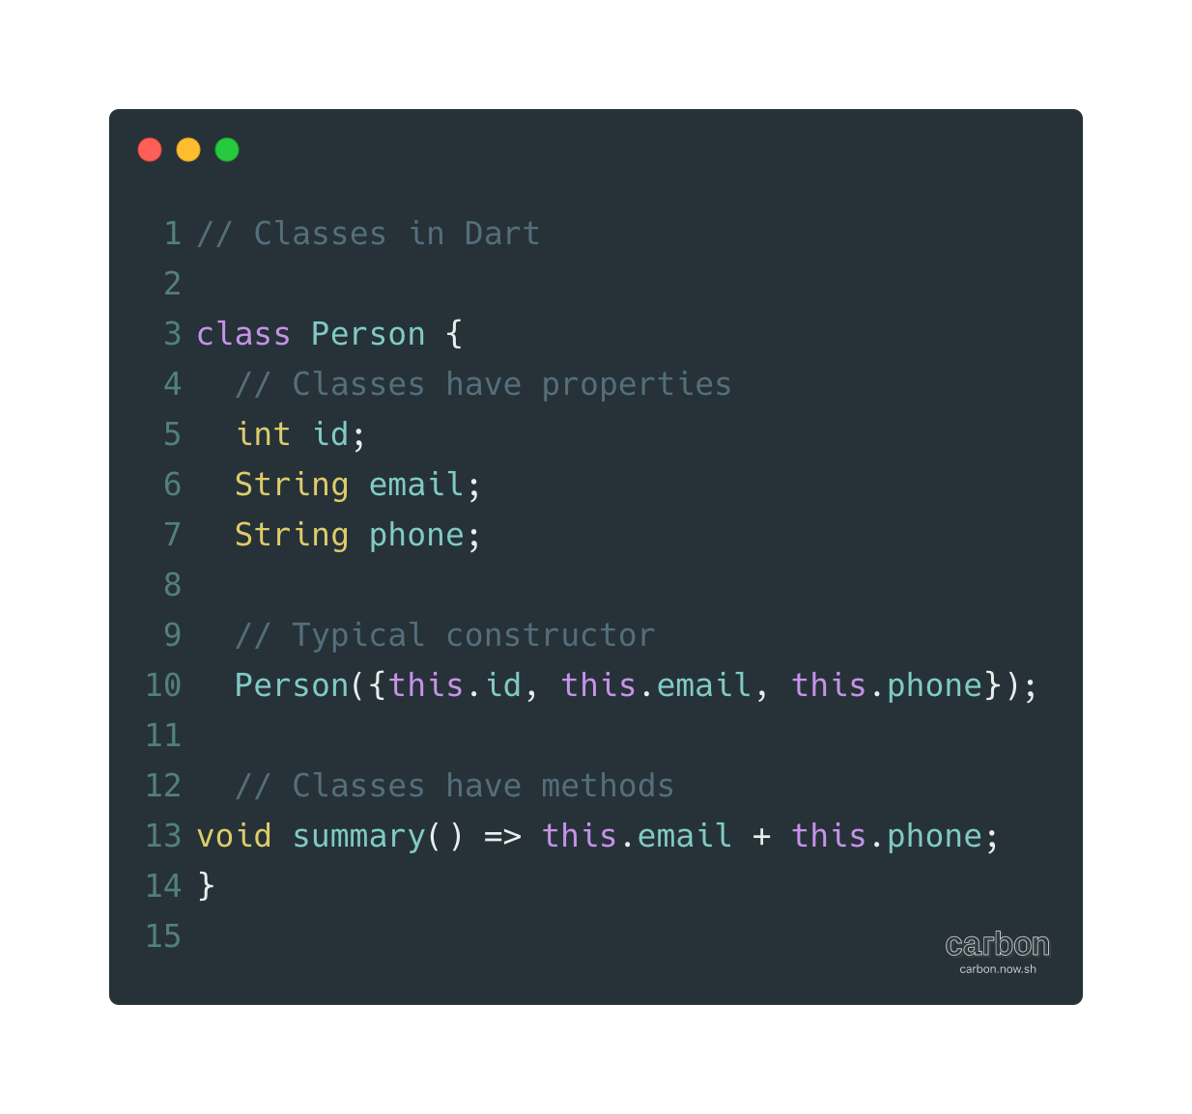

Slide 36
Resourceful Links
https://flutter.dev/ - Official flutter website
https://dart.dev/ - Official dart website
https://dartpad.dev/ - Dart Padd
Accompanying Books and Youtube links
https://b-ok.cc/book/1309331/196488 - Dart Up and Running
https://b-ok.cc/book/5336752/c75e2a - Flutter in Action
https://b-ok.cc/book/5304545/f7e889 - Beginning App dev with Flutter
https://youtu.be/I9ceqw5Ny-4?list=RDCMUCVD5Vh9LhLBxp3o1vRNyf_w - Flutter Video Setup
Project Github link
https://flutter.dev/docs/get-started/install - Flutter Setup
https://play.google.com/store/apps/details?id=com.francisdeh.timeapp - Time App
https://mega.nz/#F!vPwTESiS - Cloud link for all setups, books and videos
Github link for todo project

